Slide 1


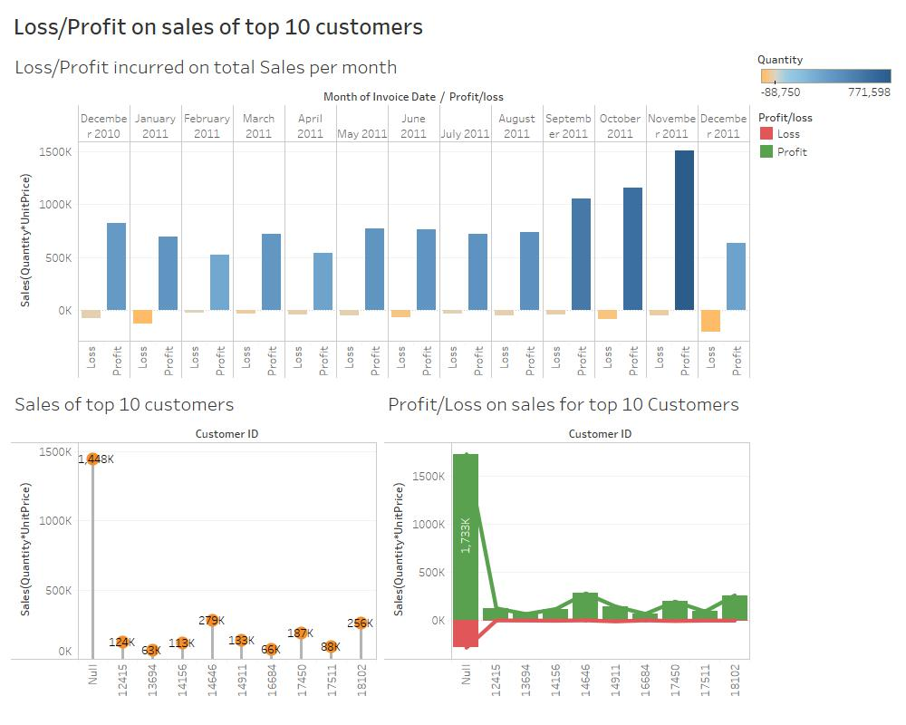
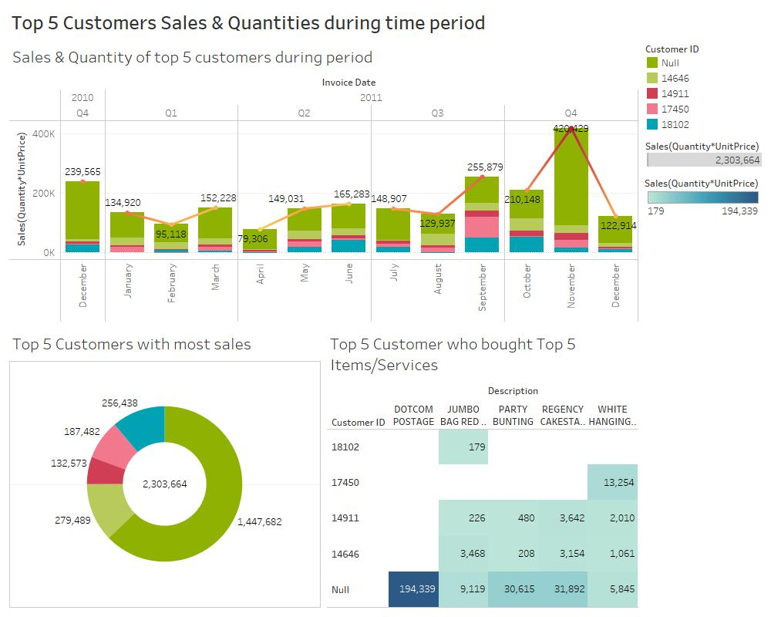
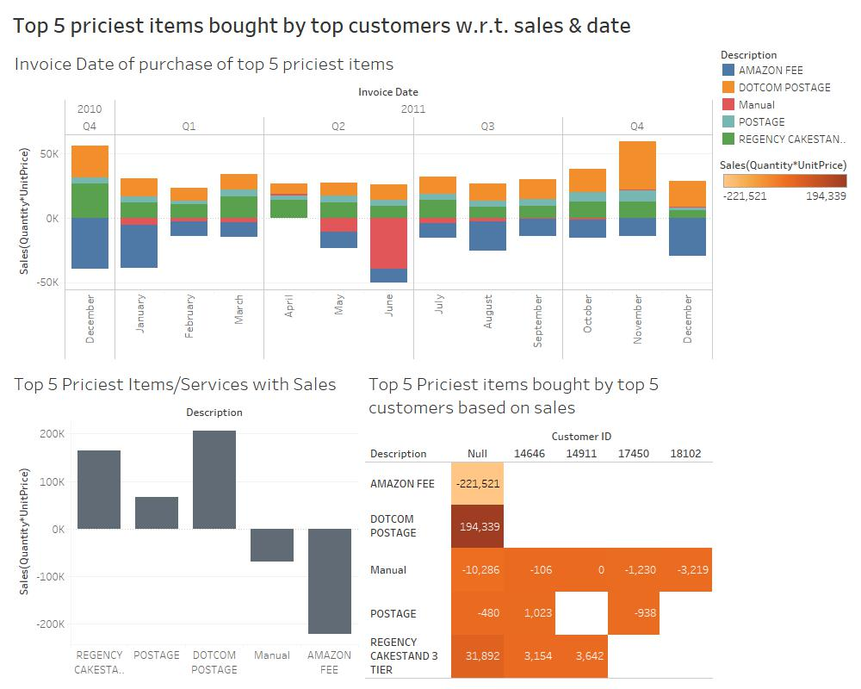
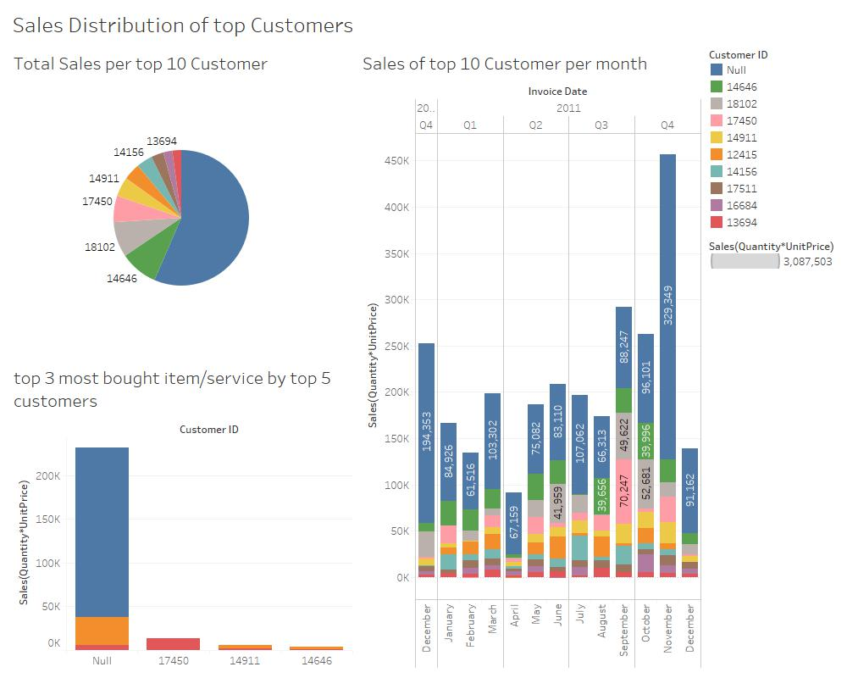
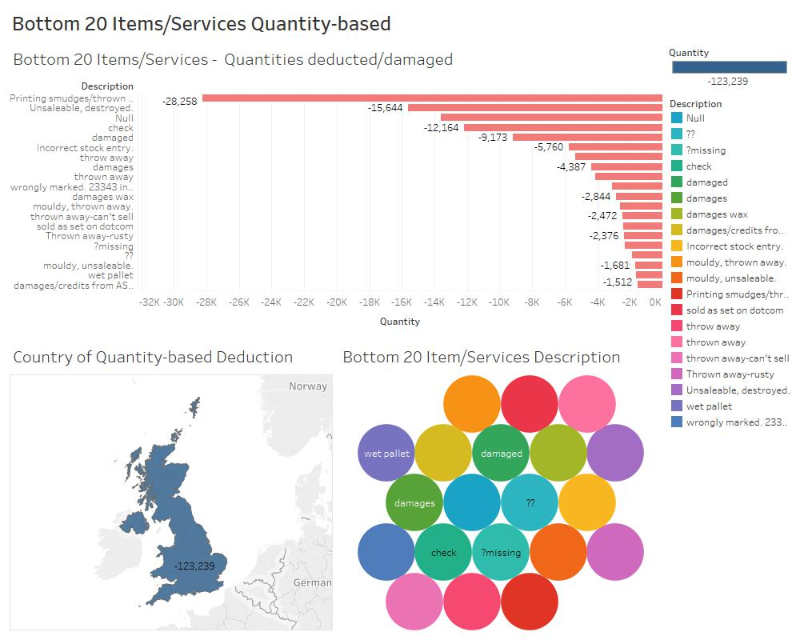
Online Retail Dataset
https://archive.ics.uci.edu/ml/datasets/Online+Retail
Pronoy D’sa - 2952742
Exploratory Data Analytics of
Online Retail Dataset:-

